Slide 1
Data Analytics - Capstone Project
Dixie Peralta
Neeraja Jayaraman
Richelle Long
Nisha Bharakhada

Slide 2




The Team
Dixie Perlata
Richelle Long
Neeraja Jayaraman
Nisha Bharakhada
Github
Database
Dashboard
Database
Presentation
Dashboard
Machine Learning Model
Presentation
Dashboard
Machine Learning Model
Presentation
Dashboard

Slide 3
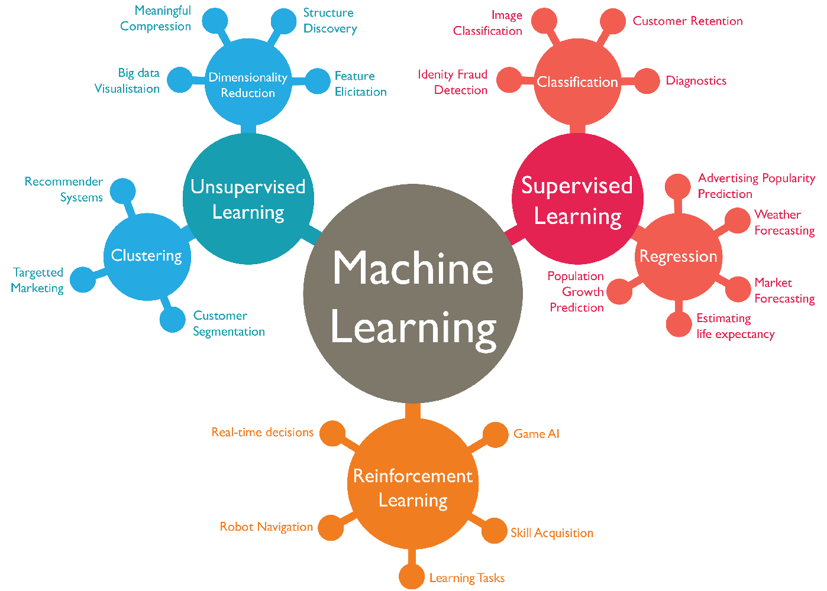



Project Details
List of dataset reviewed
Selection of dataset
Reasons for selection
Description of the data source
ML Model for prediction

Slide 4


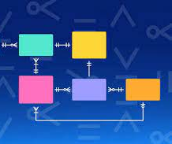




Tools/ Technologies Used

Slide 5
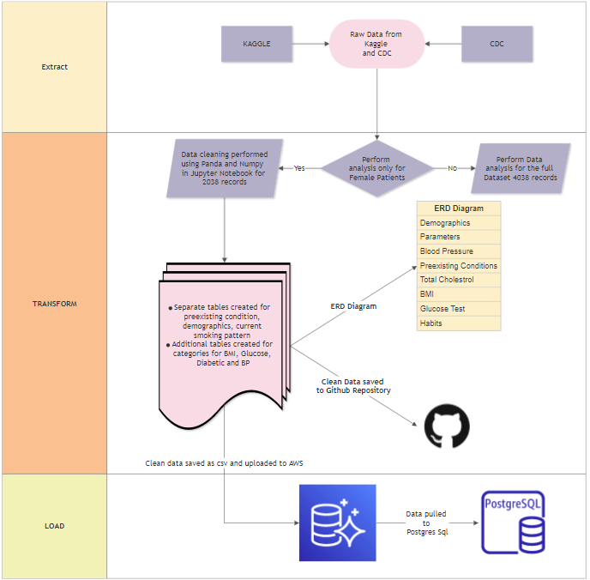

Slide 6
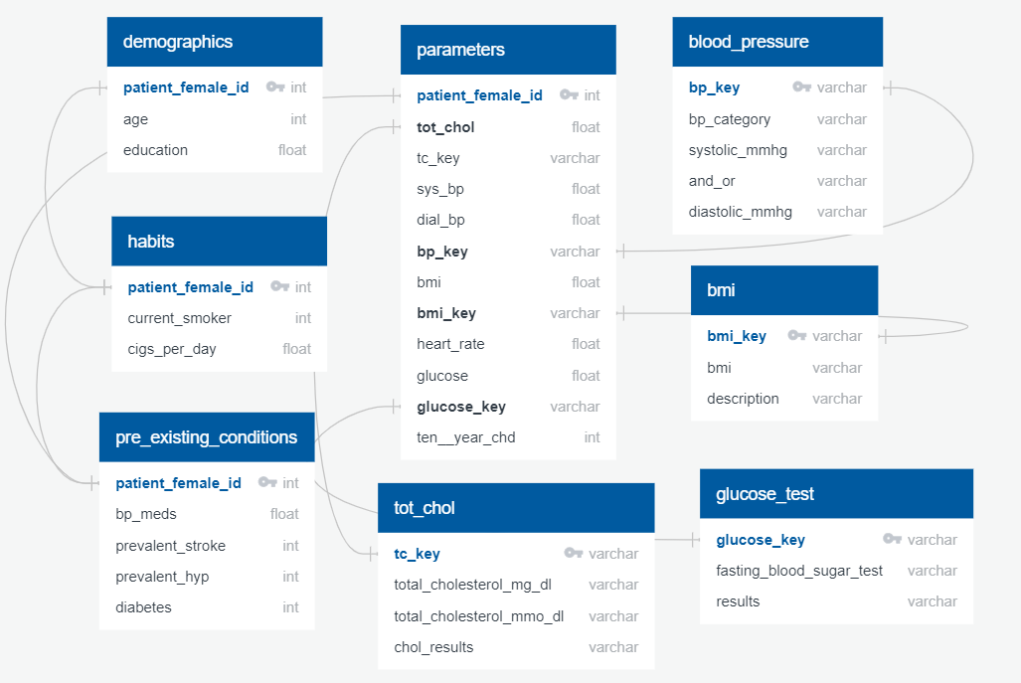
ERD Diagram
Notes:
Add ML+ ERD

Slide 7
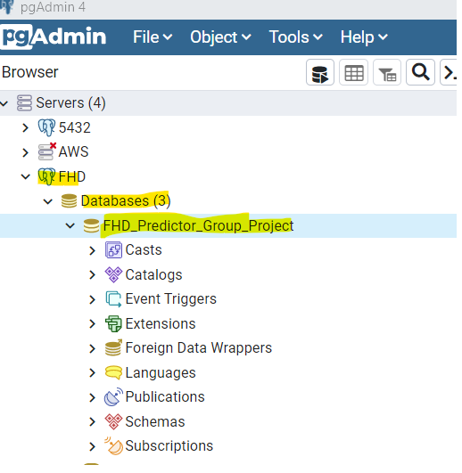
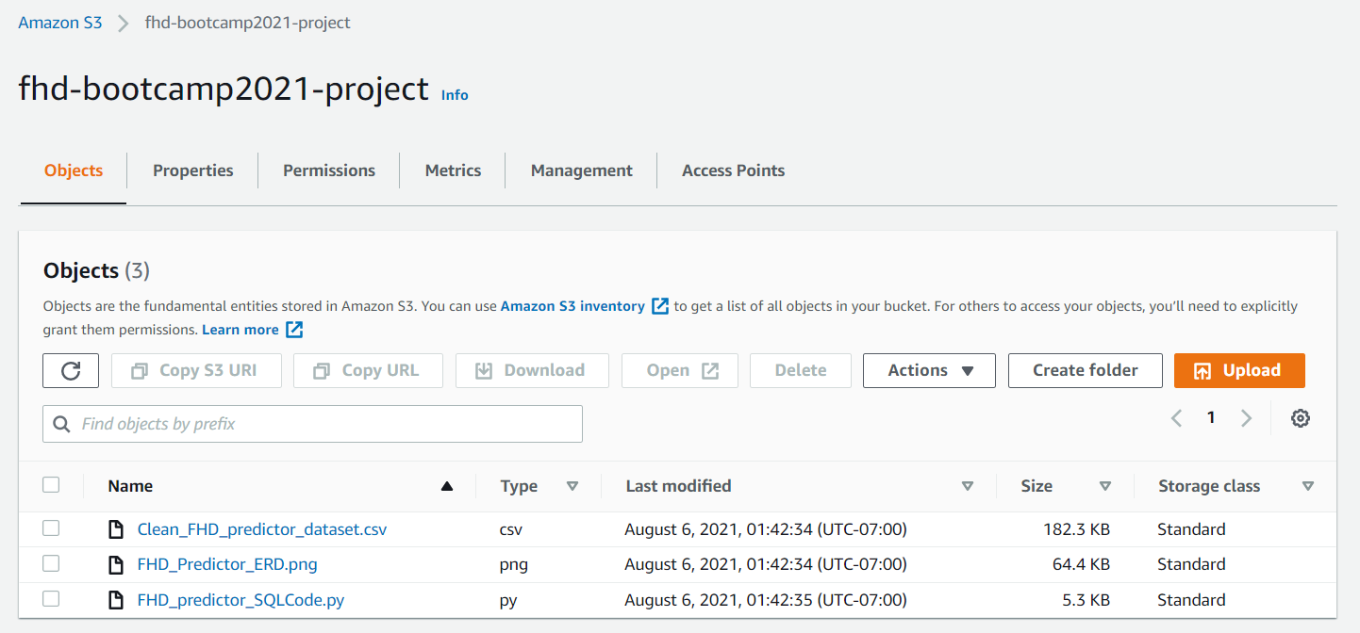
AWS to Postgres
Notes:
Add ML+ ERD

Slide 8
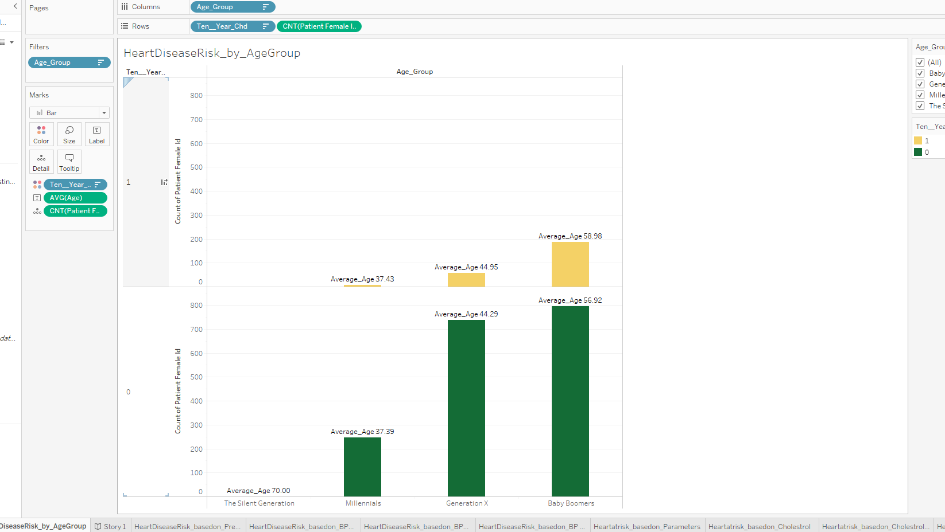
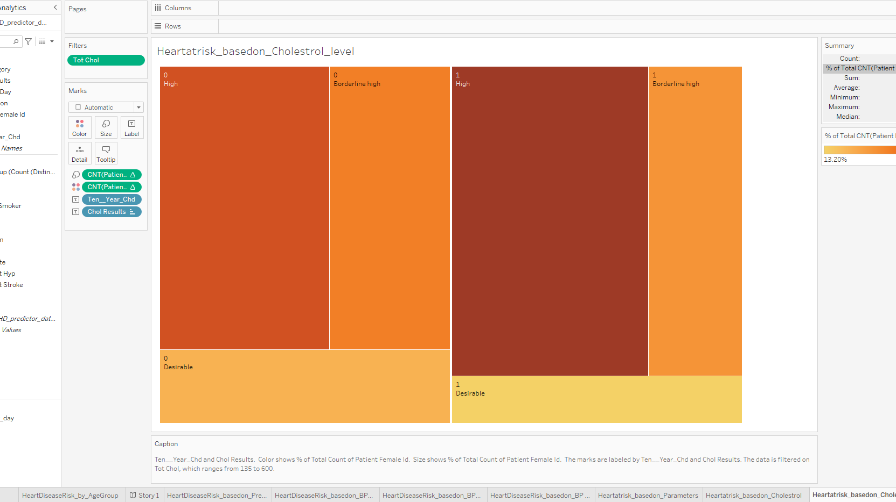
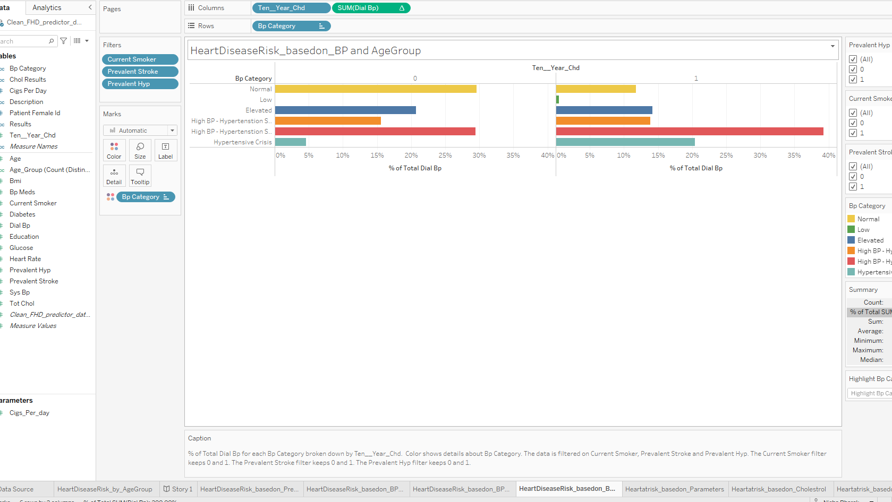
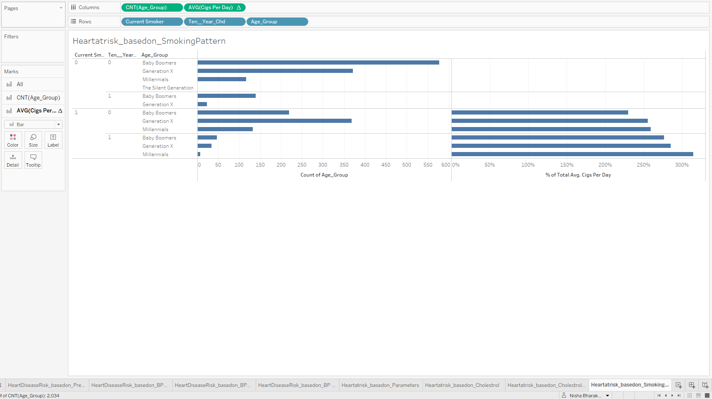
Dashboard(Data Analysis and results of Analysis)
Notes:
Add ML+ ERD

Slide 9
Features and Target Identified
Exploratory Data Analysis
Feature Selection
Feature Scaling
Application of Machine Learning Classification Models
Best Performing Model recommended
Heart Disease Prediction in Women - A Machine Learning Endeavor

Slide 10
Exploratory Data Analysis
Data Cleaning
Data Distributions
Relationships
Link to EDA graphs( or Insert Graphs here)

Slide 11
Model
Machine Learning
Techniques
Algorithms
Input Data
Output Optimum Model

Slide 12
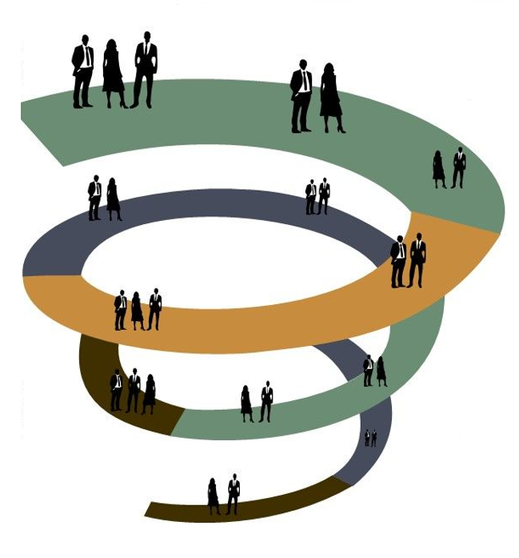
Project Lessons Learned and Challenges
Understanding Dataset
Knowledge of Domain/Subject Matter
Identifying the problem/question to resolve
Incorrect selection of dataset
Incomplete data to support the model

Slide 13
Recommendations
Database
Connecting to cloud Database
Maintaining a backup of data
Git hub
Knowledge of basic functions of Github
Maintain a clean repository
Machine Learning
Deciding Models based on Input Data
Dashboard
Reading the value of each data point in the graph
To compare the outcome using different ML model with more feature selection
Datapoint value significance vary based on domain of dataset
Include Male Heart Disease data to add more dimension to the analysis.
Further address Class Imbalance issues before trying other Machine learning Methods.
Attempt to get a better Recall score along with Accuracy
Consider other machine learning Models such as simple Neural networks
Reading datapoint and using the correct datatype for changes/enhancement/visualization
Highlight data which is statistically significant and more weightage for visualization and predicting models
Committing to individual branch
Merging when coding for each section/feature/subtask is complete
Performing data cleaning based on key feature requirement for data visualization and for ML model

Slide 14
